Slide 1
Information Systems in Decision Making
This topic will cover
Levels of decision making,
Types,
Stages,
People and their roles

Slide 2
Introduction
A decision involves a cut of alternatives between those that are desirable and those are non desirable.
Decision-making is developing concepts leading to the selection of a course of action among variations. Every decision making process produces a final choice
It can be an action or an opinion.
It begins when we need to do something but we do not know what e.g. Decision to raise a Purchase Order

Slide 3
Concept of Decision-making
Decision-making is a cognitive process that results in the selection of a course of action among several alternative scenarios.
Decision-making is a daily activity for any human being. There is no exception about that. When it comes to business organizations, decision-making is a habit and a process as well.
Effective and successful decisions result in profits, while unsuccessful ones cause losses. Therefore, corporate decision-making is the most critical process in any organization.

Slide 4
In a decision-making process, we choose one course of action from a few possible alternatives. In the process of decision-making, we may use many tools, techniques, and perceptions.
In addition, we may make our own private decisions or may prefer a collective decision.
Usually, decision-making is hard. Majority of corporate decisions involve some level of dissatisfaction or conflict with another party.

Slide 5
Decision making classification
Decision making can be classified by organizational level, as
Strategic decision making determines the objectives, resources, and policies of the organization.
Decision making for management control is mainly concerned with how efficiently and effectively resources are used and how well operational units are performing.
Operational control decision making determines how to carry out the specific tasks set out by strategic and middle management decision makers.
Knowledge-level decision making deals with evaluating new ideas for products and services, ways to communicate new knowledge, and ways to distribute information throughout the organization.

Slide 6
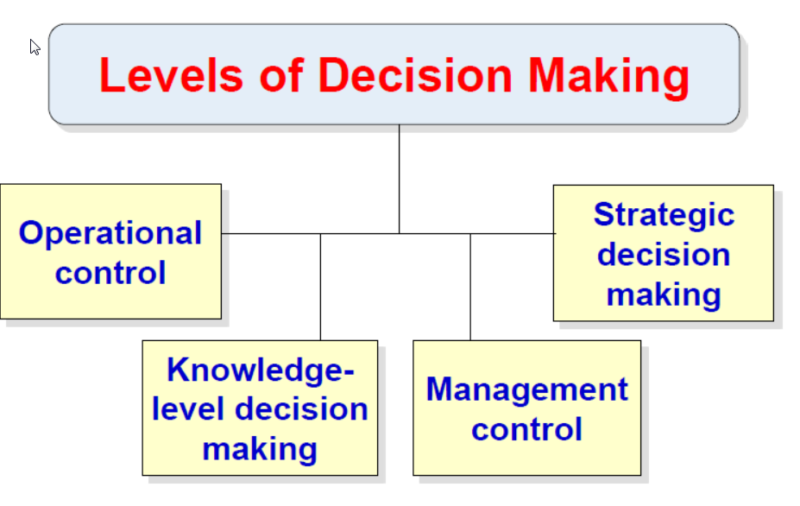

Slide 7
Operational Decisions
Operational managers and other employees make operational decisions for the company. Operational managers include mid-level, supervisory and lower-level management. Operational decisions are the day-to-day decisions that have only a short-term impact on a company.
These include, but are not limited to, decisions regarding:
Scheduling employees
Training on specific tasks in a company (e.g., sales techniques, computer training, etc.)
Purchasing office supplies
Assigning work to specific employees

Slide 8
Operational Decisions cont’d
Operational decisions generally are very specific and have a high degree of certainty. Although operational decisions alone do not have long-term or material impacts on the company, these decisions guide the implementation of strategic and tactical plans.
Operational managers must answer to a company’s officers regarding the operational decisions that operational managers make.

Slide 9
Strategic Decisions and Plans
Strategic decisions are decisions and plans that have long-term or material impact on a company.
These often include, but are not limited to, decisions regarding:
The election of officers and executives
Equity grants or transfers (including compensation packages for officers and executives)
Annual budgets and audits
Amendments to the certificate of incorporation or bylaws
Shareholder distributions
Sale of all company’s assets

Slide 10
Termination or sale of a company
Adoption of employee benefit plans
Other important agreements or long-term strategies
The guidance, directors provide to company management regarding strategy and operations is vital to a company’s long-term success.
A board of directors has important duties, so it generally must act and make decisions in the best interests of a company and its shareholders.

Slide 11
Knowledge-based decision-making
Knowledge-based decision-making in management is a decision-making process that involves an agreed standard, which is used to measure and ensure that the most suitable outcome can be generated for a specific topic.
This process is used as a guideline to make the most effective and strategic decision

Slide 12
Tactical Decisions and Plans
Officers and executives make tactical decisions for the company. Officers and executives include the CEO, COO, CFO and other top-level management in a company. Tactical decisions are decisions and plans that concern the more detailed implementation of the directors’ general strategy, usually with a medium-term impact on a company.
Tactical points requiring decisions include, but are not limited to:
Size and structure of a work force
Sales and marketing strategy
Signing non-disclosure agreements
Work assignments allocated to particular groups and people
Large purchases within a previously approved budget
Most tactical decisions and plans are more detailed than strategic decisions and plans.

Slide 13
Types Of Decisions
Within each of these levels of decision making, decisions are classified as:
Structured and
Unstructured
Unstructured decisions:
Decision maker must provide judgment, evaluation, and insights into the problem definition.
Each of these decisions are different, important, and non-routine, and there is no well-understood or agreed-on procedure for making them.

Slide 14
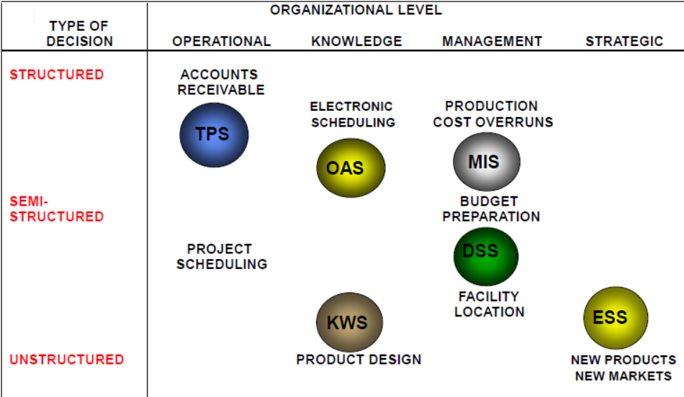
Structured decisions, Structured decisions refer to decisions that can be made using a well-defined and systematic approach based on clear criteria and available data. These decisions are typically routine and repetitive in nature and can often be automated or guided by established procedures or rule.
Some decisions are semi-structured; in such cases, only part of the problem has a clear-cut answer provided by an accepted procedure.
· Unstructured/ Non programmed
· Structured/ Programmed
· Semi-structured
Different kinds of information systems at the various organization levels support different types of decisions

Slide 15
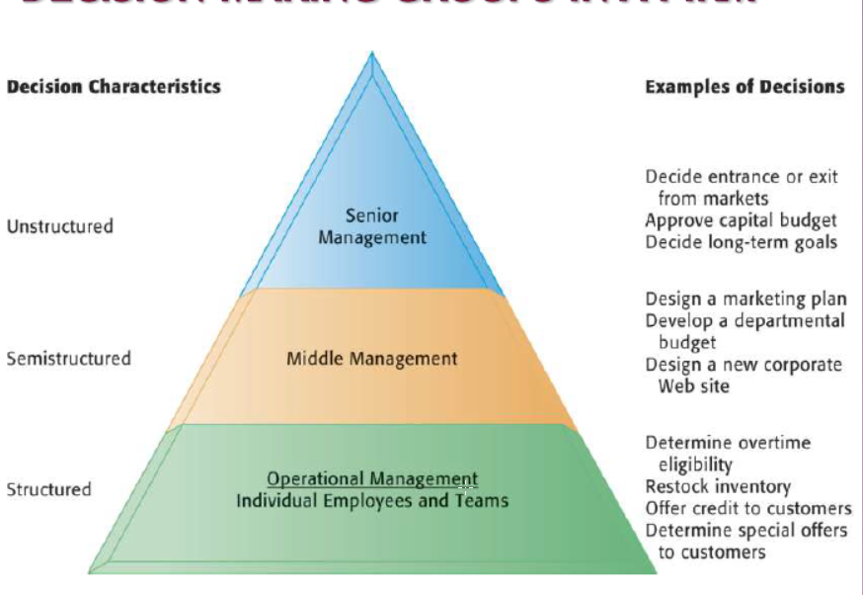
Information Requirement for Key Decision Making Groups in A Firm

Slide 16
Decision Making Process
There are four different stages in decision making:
Intelligence,
Design,
Choice, and
Implementation.

Slide 17
Decision Making Process
Intelligence
It consists of identifying and understanding the problems occurring in the organization—why the problem, where, and with what effects.
Traditional MIS deliver a wide variety of detailed information that can help identify problems, especially if the systems report exceptions.

Slide 18
Decision Making Process
solution design
During solution design, the individual designs possible solutions to the problems.
Smaller DSS systems are ideal in this stage of decision making, because they operate on simple models, can be developed quickly, and can be operated with limited data.

Slide 19
Decision Making Process
Choice
Consists of choosing among solution alternatives.
The decision maker might need a larger DSS system to develop more extensive data on a variety of alternatives and complex models or data analysis tools to account for all the costs, consequences, and opportunities

Slide 20
Decision Making Process
Solution Implementation
When the decision is put into effect, managers can use a reporting system that delivers routine reports on the progress of a specific solution.
Support systems can range from full-blown MIS systems to much smaller systems, as well as project-planning software operating on personal computers.
In general, the stages of decision making do not necessarily follow a linear path. Decisions are often arrived at after a series of iterations and evaluations at each stage in the process. The decision maker often must loop back through one or more of the stages before completing the process

Slide 21
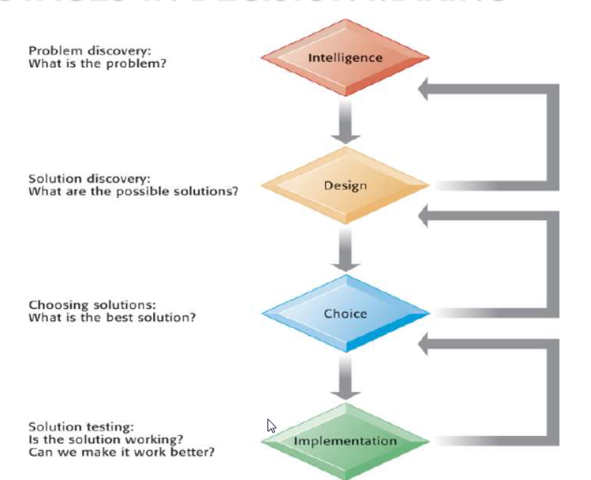
Stages in Decision making

Slide 22
Steps of Decision-Making Process
Following are the important steps of the decision-making process.
Each step may be supported by different tools and techniques.
Identification of the purpose of the decision
Information gathering
Principles for Judging the alternatives
Brainstorm and analyze the different choices
Evaluation of alternatives
Select the best alternative
Execute the decision
Evaluate the Results

Slide 23
Steps of Decision-Making Process cont’d
Step 1 − Identification of the Purpose of the Decision
In this step, the problem is thoroughly analyzed. There are a couple of questions one should ask when it comes to identifying the purpose of the decision.
What exactly is the problem?
Why the problem should be solved?
Who are the affected parties of the problem?
Does the problem have a deadline or a specific time-line?

Slide 24
Steps of Decision-Making Process cont’d
Step 2 − Information Gathering
A problem of an organization will have many stakeholders. In addition, there can be dozens of factors involved and affected by the problem.
In the process of solving the problem, you will have to gather as much as information related to the factors and stakeholders involved in the problem. For the process of information gathering, tools such as 'Check Sheets' can be effectively used.

Slide 25
Steps of Decision-Making Process cont’d
Step 3 − Principles for Judging the Alternatives
In this step, the baseline criteria for judging the alternatives should be set up. When it comes to defining the criteria, organizational goals as well as the corporate culture should be taken into consideration.
As an example, profit is one of the main concerns in every decision making process. Companies usually do not make decisions that reduce profits, unless it is an exceptional case. Likewise, baseline principles should be identified related to the problem in hand.

Slide 26
Steps of Decision-Making Process cont’d
Step 4 − Brainstorm and Analyze the Choices
For this step, brainstorming to list down all the ideas is the best option. Before the idea generation step, it is vital to understand the causes of the problem and prioritize causes.
For this, you can make use of Cause-and-Effect diagrams and Pareto Chart tool. Cause-and-Effect diagram helps you to identify all possible causes of the problem and Pareto chart helps you to prioritize and identify the causes with the highest effect.
Then, you can move on generating all possible solutions (alternatives) for the problem at hand.

Slide 27
Steps of Decision-Making Process cont’d
Step 5 − Evaluation of Alternatives
Use your judgment principles and decision-making criteria to evaluate each alternative. In this step, experience and effectiveness of the judgment principles come into play. You need to compare each alternative for their positives and negatives.

Slide 28
Steps of Decision-Making Process cont’d
Step 6 − Select the Best Alternative
Once you go through from Step 1 to Step 5, this step is easy. In addition, the selection of the best alternative is an informed decision since you have already followed a methodology to derive and select the best alternative.

Slide 29
Steps of Decision-Making Process cont’d
Step 7 − Execute the decision
Convert your decision into a plan or a sequence of activities. Execute your plan by yourself or with the help of subordinates.

Slide 30
Steps of Decision-Making Process cont’d
Step 8 − Evaluate the Results
Evaluate the outcome of your decision. See whether there is anything you should learn and then correct in future decision making. This is one of the best practices that will improve your decision-making skills.

Slide 31
Process and Modeling in Decision-Making
There are two basic models in decision-making −
Rational models
Normative model

Slide 32
Rational Models
The rational models are based on cognitive judgments and help in selecting the most logical and sensible alternative.
Examples of such models include - decision matrix analysis, SWOT analysis, Pareto analysis and decision trees, selection matrix, etc.
A rational decision making model takes the following steps −
Identifying the problem,
Identifying the important criteria for the process and the result,
Considering all possible solutions,
Calculating the consequences of all solutions and comparing the probability of satisfying the criteria,
Selecting the best option.

Slide 33
Normative Model
The normative model of decision-making considers constraints that may arise in making decisions, such as time, complexity, uncertainty, and inadequacy of resources.
According to this model, decision-making is characterized by −
Limited information processing - A person can manage only a limited amount of information.
Judgmental heuristics - A person may use shortcuts to simplify the decision making process.
Satisfying - A person may choose a solution that is just "good enough".

Slide 34
Dynamic Decision-Making
Dynamic decision-making (DDM) is synergetic, decision-making involving interdependent systems, in an environment that changes over time either due to the previous actions of the decision-maker or due to events that are outside of the control of the decision-maker.
These decision-makings are more complex and real-time.
Dynamic decision-making involves observing how people used their experience to control the system's dynamics and noting down the best decisions taken thereon.
Sensitivity Analysis
Sensitivity analysis is a technique used for distributing the uncertainty in the output of a mathematical model or a system to different sources of uncertainty in its inputs.

Slide 35
From business decision perspective, the sensitivity analysis helps an analyst to identify cost drivers as well as other quantities to make an informed decision. If a particular quantity has no bearing on a decision or prediction, then the conditions relating to quantity could be eliminated, thus simplifying the decision making process. Sensitivity analysis also helps in some other situations, like
Resource optimization
Future data collections
Identifying critical assumptions
To optimize the tolerance of manufactured parts

Slide 36
Static and Dynamic Models
Static models:
Show the value of various attributes in a balanced system.
Work best in static systems.
Do not take into consideration the time-based modifications.
Do not work well in real-time systems however, it may work in a dynamic system being in equilibrium
Involve less data.
Are easy to analyze.
Produce faster results.

Slide 37
Dynamic models
Consider the change in data values over time.
Consider effect of system behavior over time.
Re-calculate equations as time changes.
Can be applied only in dynamic systems.

